Slide 1
NLTK Essentials
Introduction to Natural Language
Processing (NLP)
Presentation presenter: Plessias alexandros

Slide 2
Presentation’s content
Introduction to Natural Language Processing
Why learn NLP?
Installation of Python & NLTK
Let's start playing with Python!
Code example

Slide 3
Introduction to Natural Language Processing

Slide 4
Introduction to Natural Language Processing (1/2)
Natural language processing (NLP) is a field of computer science, artificial intelligence (AI) and computational linguistics concerned with the interactions between computers and human (natural) languages.
Challenges in natural language processing (NLP) frequently involve natural language understanding, natural language generation, dialog systems, or some combination thereof.
The study of language processing is called NLP. People who are deeply involved in the study of language are linguists, while the term 'computational linguist' applies to the study of processing languages with the application of computation.
Essentially, a computational linguist will be a computer scientist who has enough understanding of languages, and can apply his computational skills to model different aspects of the language. While computational linguists address the theoretical aspect of language, NLP is nothing but the application of computational linguistics.
Notes:
While computational linguists address the theoretical aspect of language, NLP is nothing but the application of computational linguistics.
Ενώ οι υπολογιστικοί γλωσσολόγοι αντιμετωπίζουν τη θεωρητική πτυχή της γλώσσας, το NLP δεν είναι παρά η εφαρμογή της υπολογιστικής γλωσσολογίας.

Slide 5
Introduction to Natural Language Processing (2/2)
NLP is more about building real-world applications using NLP techniques. In a practical context, NLP is analogous to teaching a language to a child.
Some of the most common tasks like understanding words, sentences, and forming grammatically and structurally correct sentences, are very natural to humans. In NLP, some of these tasks translate to tokenization, chunking, part of speech tagging, parsing, machine translation, speech recognition, and most of them are still the toughest challenges for computers.
Notes:
forming grammatically and structurally correct sentences = σχηματίζοντας γραμματικά και δομικά ορθές προτάσεις

Slide 6
Why learn NLP?

Slide 7
Why learn NLP?
NLP is one of the rarest skill sets that is required in the industry. After the advent of big data, the major challenge is that we need more people who are good with not just structured, but also with semi or unstructured data.
We are generating petabytes of Weblogs, tweets, Facebook feeds, chats, emails, and reviews. Companies are collecting all these different kind of data for better customer targeting and meaningful insights. To process all these unstructured data source we need people who understand NLP.
We are in the age of information; we can't even imagine our life without Google. We use Siri for the most of basic stuff. We use spam filters for filtering spam emails. We need spell checker on our Word document. There are many examples of real world NLP applications around us.

Slide 8
Some NLP applications
Some examples of the amazing NLP applications that you can use, but are not aware that they are built on NLP:
Spell correction (MS Word/ any other editor)
Search engines (Google, Bing, Yahoo, wolframalpha)
Speech engines (Siri , Cortana, Google Voice & Now, Alexa - Amazon Echo)
Spam classifiers (All e-mail services)
News feeds (Google, Yahoo!, and so on)
Machine translation (Google Translate, and so on)
IBM Watson
Google Cloud Natural Language API (https://cloud.google.com/natural-language/)
Amazon Lex (https://aws.amazon.com/lex/)
Notes:
but are not aware = αλλά δεν γνωρίζουμε

Slide 9
NLP Tools (1/2)
To achieve some of the above applications and other basic NLP preprocessing, there are many open source tools available. Some of them are developed by organizations to build their own NLP applications, while some of them are open-sourced. Here is a small list of available NLP tools:
GATE (release 1995, Java)
Mallet (release 2002,Java)
Open NLP (release 2004, Java or C# or R)
UIMA (release 2006, Java, C++)
Stanford toolkit (release 2014, Java)
Genism (release 2008, Python)
Natural Language Tool Kit (NLTK) (release 2001, Python)
Notes:
Για να επιτευχθούν κάποιες από τις παραπάνω εφαρμογές και άλλες βασικές προ επεξεργασίες NLP,
υπάρχουν πολλά διαθέσιμα εργαλεία ανοιχτού κώδικα. Ορισμένες από αυτές αναπτύσσονται από οργανισμούς
για να δημιουργήσουν τις δικές τους εφαρμογές NLP, ενώ ορισμένες από αυτές είναι ανοιχτές.
Εδώ είναι μια μικρή λίστα με τα διαθέσιμα εργαλεία NLP:

Slide 10
NLP Tools (2/2)
Most of the tools are written in Java and have similar functionalities. Some of them are robust and have a different variety of NLP tools available.
However, when it comes to the ease of use and explanation of the concepts, NLTK scores really high. NLTK is also a very good learning kit because the learning curve of Python (on which NLTK is written) is very fast. NLTK has incorporated most of the NLP tasks, it's very elegant and easy to work with. For all these reasons, NLTK has become one of the most popular libraries in the NLP community.
Notes:
Τα περισσότερα από τα εργαλεία είναι γραμμένα σε Java και έχουν παρόμοιες λειτουργίες.
Ορισμένες από αυτές είναι ισχυρές και διαθέτουν διαφορετική ποικιλία εργαλείων NLP.
Ωστόσο, όταν πρόκειται για την ευκολία χρήσης και την εξήγηση των εννοιών, τα αποτελέσματα της
NLTK είναι πολύ υψηλά. Το NLTK είναι επίσης ένα πολύ καλό για την εκμάθηση επειδή η καμπύλη μάθησης της
Python (στην οποία είναι γραμμένο NLTK) είναι πολύ γρήγορη. Το NLTK έχει ενσωματώσει τις περισσότερες εργασίες
NLP, είναι πολύ κομψό και εύκολο στη χρήση. Για όλους αυτούς τους λόγους, το NLTK έχει γίνει μια από τις πιο
δημοφιλείς βιβλιοθήκες της κοινότητας NLP.

Slide 11
Installation of Python & NLTK

Slide 12
Python install
NLTK requires Python versions 2.7, 3.4, or 3.5
Official Distribution : https://www.python.org/downloads/
Anaconda Distribution : http://continuum.io/downloads
Canopy Distribution : https://store.enthought.com/downloads/
Anaconda and Canopy Python distributions come bundled with NLTK library.

Slide 13
NLTK install (for Windows)
NLTK requires Python versions 2.7, 3.4, or 3.5
Install Python 3.5: https://www.python.org/downloads/release/python-350/ (avoid the 64-bit versions)
Install Numpy (optional - scientific computing with Python): http://sourceforge.net/projects/numpy/files/NumPy/ (the version that specifies python3.5)
Install NLTK: http://pypi.python.org/pypi/nltk
Test installation: Start>Python35, then type: import nltk
Alternative of Step 3:
Install get-pip.py (tool for installing and managing Python packages)* : https://pip.pypa.io/en/stable/installing/
Open Command Prompt and run command: python -m pip install nltk
* exists in Python’s versions >= 3.4

Slide 14
Let's start playing with Python!
We'll not be diving too deep into Python however, we'll give you a quick tour of Python essentials
Notes:
Δεν θα βουτήξουμε στα πολύ βαθιά της Python.
Αλλά θα σας δώσουμε μια γρήγορη περιήγηση στα απαραίτητα της Python

Slide 15
Lists
Lists are one of the most commonly used data structures in Python. They are pretty much comparable to arrays in other programming languages. Let's start with some of the most important functions that a Python list provide.
list[start : end : step] # start through end-1, by default step = 1
list[start : end] # items start through end-1 list[start:] # items start through the rest of the array list[:end] # items from the beginning through end-1
a[-1] # last item in the array list[-2:] # last two items in the array list[:-2] # everything except the last two items

Slide 16
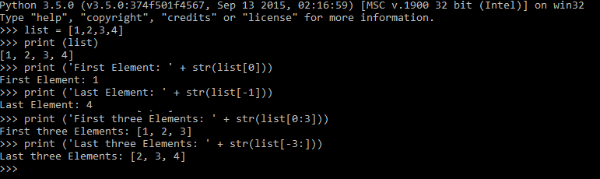
Lists examples

Slide 17
Strings
Strings in Python are very similar to other languages, but the manipulation of strings is one of the main features of Python. It's immensely easy to work with strings in Python. Even something very simple, like splitting a string, takes effort in Java / C, while you will see how easy it is in Python.
Let's have some more examples with the other most commonly used methods for strings:
Split: This is a method to split the string based on some delimiters. If no argument is provided it assumes whitespace as delimiter.
Strip: This is a method that can remove trailing whitespace, like '\n', '\n\r' from the string.
Upper/Lower: We can change the case of the string using these methods.
Replace: This will help you substitute a substring from the string.
There are tons of string functions. I have just talked about some of the most frequently used.
Notes:
immensely = εξαιρετικά

Slide 18
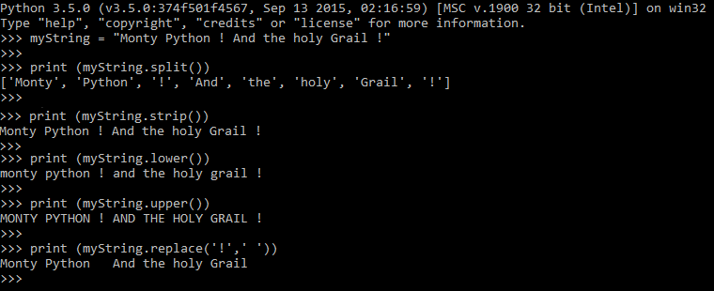
Strings examples

Slide 19
Regular expressions (1/2)
Regular expression is effectively pattern matching on. We heavily use pattern extrication to get meaningful information from large amounts of messy text data. The following are all the regular expressions you need.
(a period): This expression matches any single character except newline \n.
\w: This expression will match a character or a digit equivalent to [a-z A-Z 0-9]
\W: (upper case W) matches any non-word character.
\s: This expression (lowercase s) matches a single whitespace character - space, newline, return, tab, form [\n\r\t\f].
\S: This expression matches any non-whitespace character.
\t: This expression performs a tab operation.
Notes:
Η κανονική έκφραση είναι αποτελεσματική για την αντιστοίχιση μοτίβων. Χρησιμοποιούμε έντονα την απομάκρυνση μοτίβων
για να λάβουμε σημαντικές πληροφορίες από μεγάλες ποσότητες ακατάστατων δεδομένων κειμένου. Τα παρακάτω είναι
όλες οι κανονικές εκφράσεις που χρειάζεστε.

Slide 20
Regular expressions (2/2)
\n: This expression is used for a newline character.
\r: This expression is used for a return character.
\d: Decimal digit [0-9].
^: This expression is used at the start of the string.
$: This expression is used at the end of the string.
\: This expression is used to nullify the specialness of the special character. For example, you want to match the $ symbol, then add \ in front of it.
Notes:
This expression is used to nullify the specialness of the special character Αυτή η έκφραση χρησιμοποιείται για την εξουδετέρωση της ιδιαιτερότητας του ειδικού χαρακτήρα

Slide 21
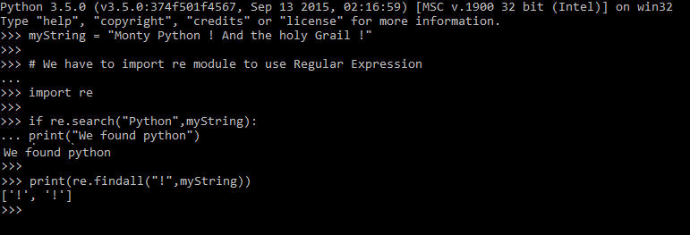
Regular expressions examples

Slide 22
Dictionaries
The other most commonly used data structure is dictionaries. Dictionaries are data structures that are indexed by keys, which can be any immutable type (such as strings and numbers) can always be keys.
Dictionaries are handy data structure that used widely across programming languages to implement many algorithms. Python dictionaries are one of the most elegant implementations of hash tables in any programming language.
It's so easy to work around dictionary, and the great thing is that with few nuggets of code you can build a very complex data structure, while the same task can take so much time and coding effort in other languages.
This gives the programmer more time to focus on algorithms rather than the data structure itself.
Notes:
immutable type = αμετάβλητος τύπος
with few nuggets of code = με λίγα ψήγματα κώδικα

Slide 23
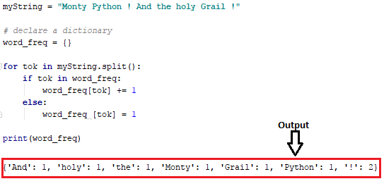
Dictionaries example
I am using one of the very common use cases of dictionaries to get the frequency distribution of words in a given text. With just few lines of the following code, you can get the frequency of words.
Notes:
frequency distribution of words = κατανομή συχνότητας των λέξεων

Slide 24

Writing functions
As any other programming language Python also has its way of writing functions.
Function in Python start with keyword def followed by the function name and parentheses (). Similar to any other programming language any arguments and the type of the argument should be placed within these parentheses. The actual code starts with (:) colon symbol.
The initial lines of the code are typically doc string (comments), then we have code body and function ends with a return statement.

Slide 25
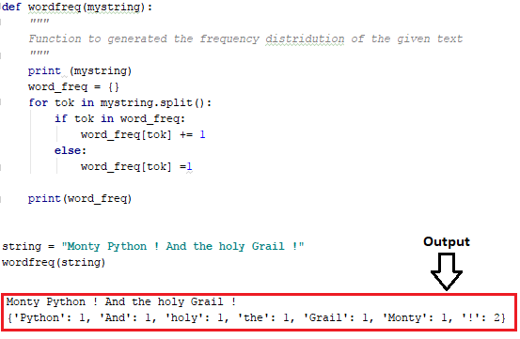
Writing functions example
For example in the given example the function wordfreq :

Slide 26
Code example (url_to_tokens.py)
We will start analyzing with some example text content. For the current example, I have taken the content from Python's home page. We don't have any clue about the kind of topics that are discussed in this URL, so let's start with an exploratory data analysis (EDA).
Typically in a text domain, EDA can have many meanings, but will go with a simple case of what kinds of terms dominate the document.
What are the topics? How frequent they are? The process will involve some level of preprocessing steps. We will try to do this first in a pure Python way, and then we will do it using NLTK.
Notes:
exploratory data analysis (EDA) = διερευνητική ανάλυση δεδομένων

Slide 27
Questions
?
Notes:
Ερωτήσεις απορίες παρατηρήσεις ?

